Slide 1

MEDICAL MICROBIOLOGY AND INFECTIOUS DISEASES
CODING WORKSHOP
Presents
Data visualization using antiviral drug-repurposing results from CLUE
INSTRUCTED BY
MacKenzie Wilke (MSc Student)
Email: sarvism@myumanitoba.ca
Educational series supported by the Department of MMID to promote knowledge translation and dissemination among students and researchers

Slide 2
INFORMATION FOR PARTICIPANTS
All workshops are being recorded and posted to the
MMID Coding Workshop - YouTube
Question and Answer period will not be recorded.

Slide 3
Last 3 Workshops…
Introduction to R (Rstudio, R scripts, R markdown)
Grace E. Seo
Tidy data in R (Transforming and combining data)
Molly Pratt
Visualizing data using R (ggplot2)
Samantha Lee

Slide 4
LEARNING OBJECTIVES
Understand what drug repurposing analyses are and how to use it as a tool for host-pathogen data
Create a basic plot in R to visualize CLUE results
Refine R plot components for specific colours, shapes and sizes
Combine multiple plots in R and output as a file to the desktop
Learn how to produce a similar graph in Tableau

Slide 5
LEARNING OBJECTIVES
Understand what drug repurposing analyses are and how to use it as a tool for host-pathogen data
Create a basic plot in R to visualize CLUE results
Refine R plot components for specific colours, shapes and sizes
Combine multiple plots in R and output as a file to the desktop
Learn how to produce a similar figure in Tableau

Slide 6
Drug Repurposing Analyses
Purpose: Identify potential small molecules
that have the opposing gene expression profiles to the profile that you have used as input
Proof: inclusion of genetic evidence in drug
development pipelines has been shown to
increase success by at least two-fold
Gene expression: is determined by z-score, fold change, etc
Viral infection associated
Drug-induced antiviral gene expression profiles
CLUE/CMap

Slide 7
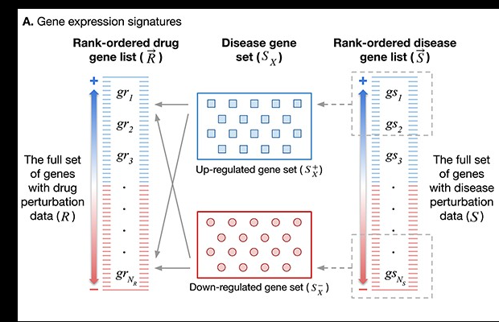
Kewalin Samart, Phoebe Tuyishime, Arjun Krishnan, Janani Ravi, Reconciling multiple connectivity scores for drug repurposing, Briefings in Bioinformatics, Volume 22, Issue 6, November 2021, bbab161, https://doi.org/10.1093/bib/bbab161

Slide 8
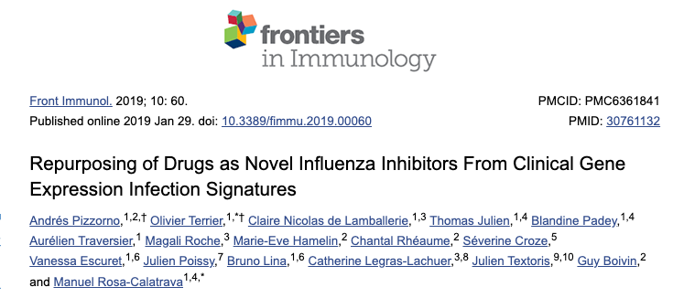
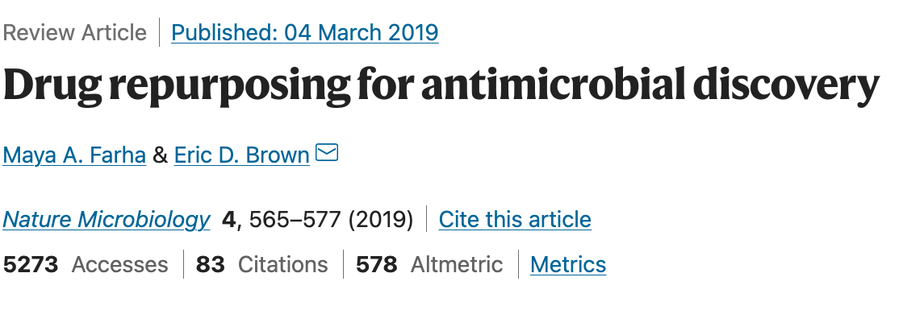
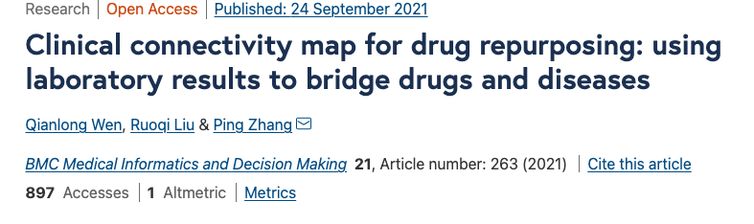

Slide 9
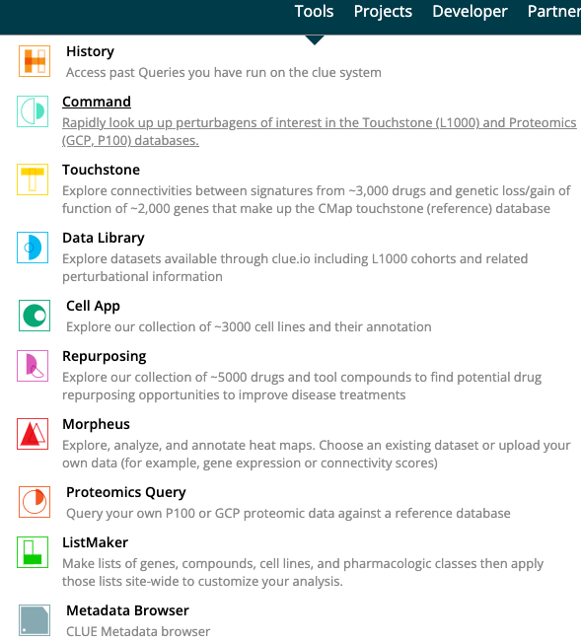
CLUE
Cloud-based infrastructure
Houses the CMap data
Gene expression information for over 30,000 perturbagens

Slide 10
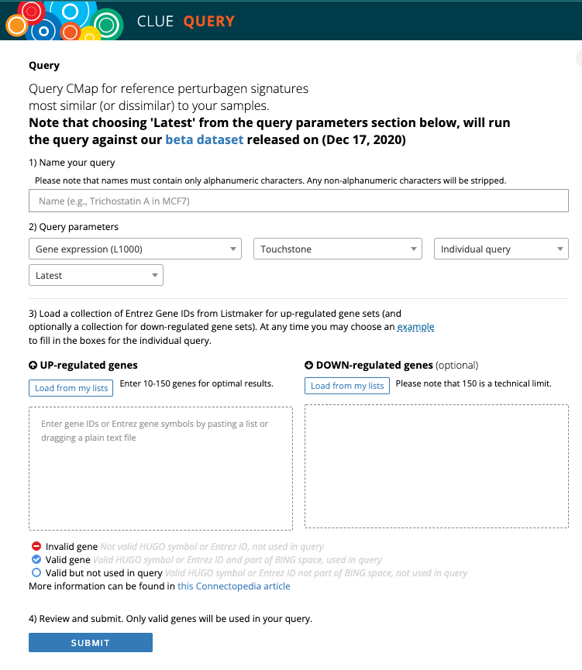
Four types of CMap Queries
Gene expression
Up and down regulated genes
Cell viability
Up and down regulated cell sets
Proteomics – Phosphorylation
GCT file
Proteomics – Histone Modifications
GCT file

Slide 11
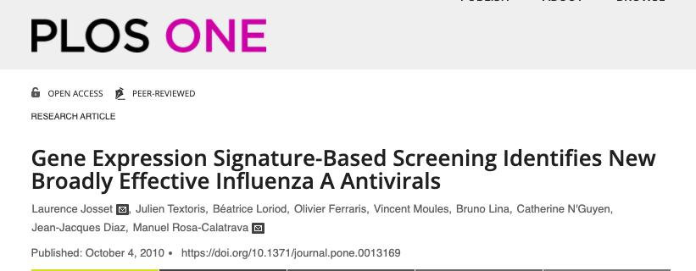
PMID: 20957181
Method: Used viral-infected human cells to obtain a list of differently expressed genes (via fold change)
Hypothesis: Perturbagens in CMap with an opposite gene expression to input may be candidate antivirals

Slide 12

Drug Repurposing Files to Visualize
Josset et al., in supplementary table 5 have a list of up and down regulated genes that was input into the CLUE Query box
As this experiment was done in a previous version of CLUE, two other down regulated genes had to be put in as requirements have changed for input
I am using an arbitrary cut off: 0.77
**This is just for learning purposes, not to replicate this study’s results**

Slide 13
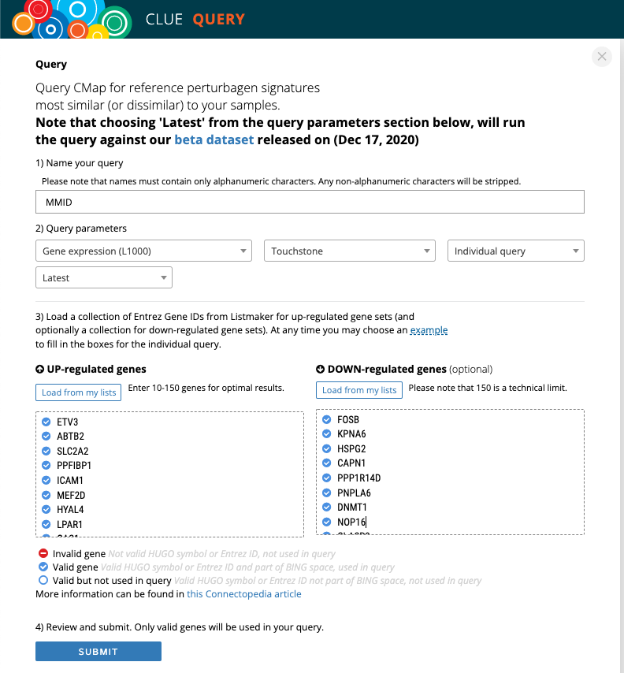
GSEA Results
Query Results

Slide 14
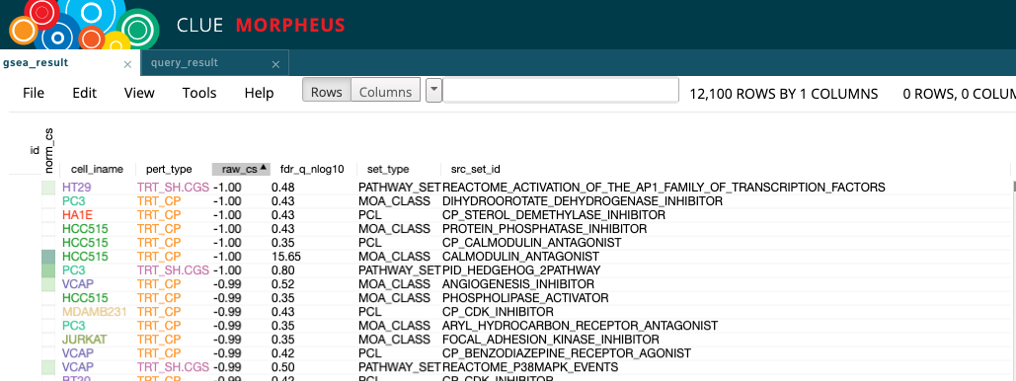
Perturbagen type
Median connectivity score
Mechanism of action
Notes:
Gene Set Enrichment Analysis (GSEA) is a computational method that determines whether an a priori defined set of genes shows statistically significant, concordant differences between two biological states (e.g. phenotypes).

Slide 15
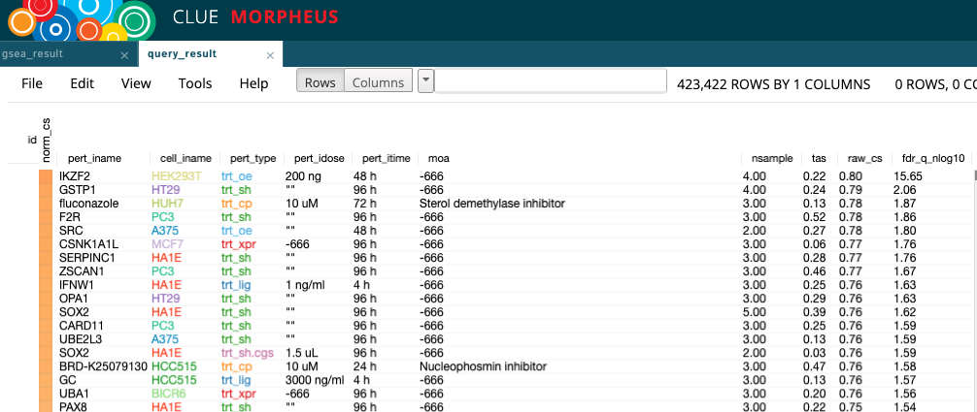
Perturbagen
Perturbagen type
Mechanism of action
Median connectivity score

Slide 16
LEARNING OBJECTIVES
Understand what drug repurposing analyses are and how to use it as a tool for host-pathogen data
Create a basic plot in R to visualize CLUE results
Refine R plot components for specific colours, shapes and sizes
Combine multiple plots in R and output as a file to the desktop
Learn how to produce a similar figure in Tableau

Slide 17

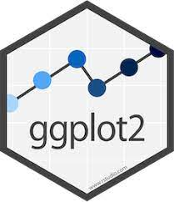
Explanation of Libraries
dplyr: A Grammar of Data Manipulation
Core package of the tidyverse
snakecase: Convert Strings into any Case
A string is an array of 1 or more characters (ex: words)
ggplot2: Main data visualization package in R
plotly: Helps make interactive figures/graphs in R
cowplot: Add on to ggplot2
To make figures publication ready
Combine different types of plots
readxl: Reads in Excel files (.xls, .xlsx)
https://englelab.gatech.edu/useRguide/data-manipulation-using-dplyr.html; https://ggplot2.tidyverse.org/

Slide 18

Purpose of making a scatterplot
To show different types of perturbagens
To show median connectivity score range
To show in blue/red colours, which perturbagens show a highly dissimilar expression profile and a highly similar expression profile

Slide 19
Going over to RStudio…

Slide 20
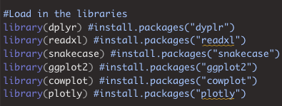
Loading in the Libraries

Slide 21
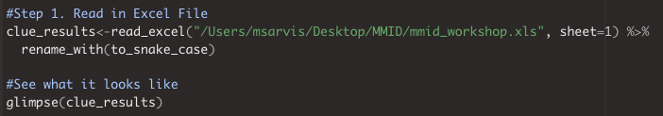
Make a scatterplot of sheet 1 results
Step 1. Read in Excel file and see what data looks like
Step 2. Change the perturbagen names into a factor and give it levels

Slide 22
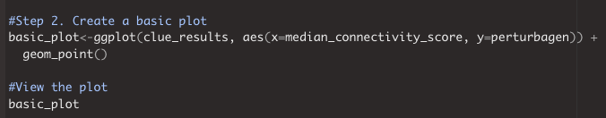
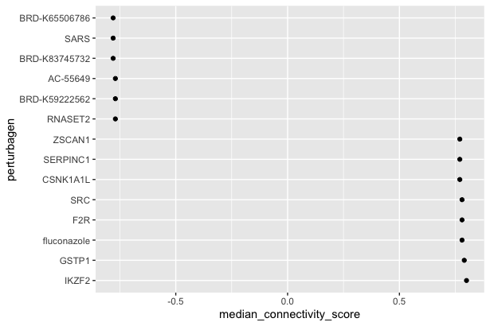
Step 3. Create a basic scatterplot with ggplot2

Slide 23
LEARNING OBJECTIVES
Understand what drug repurposing analyses are and how to use it as a tool for host-pathogen data
Create a basic plot in R to visualize CLUE results
Refine R plot components for specific colours, shapes and sizes
Combine multiple plots in R and output as a file to the desktop
Learn how to produce a similar figure in Tableau

Slide 24
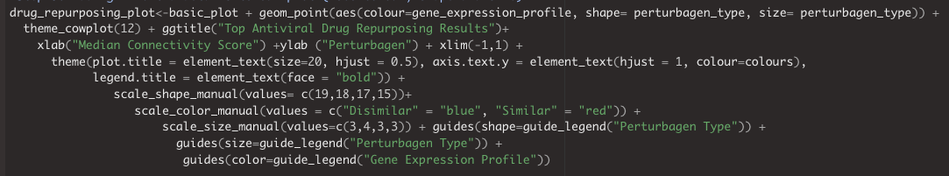
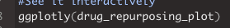
Step 4. Change the colour of the perturbagens based on their connectivity score
Step 5. Adding in details for colour, shape and sizes
*Bonus: See it interactively!

Slide 25
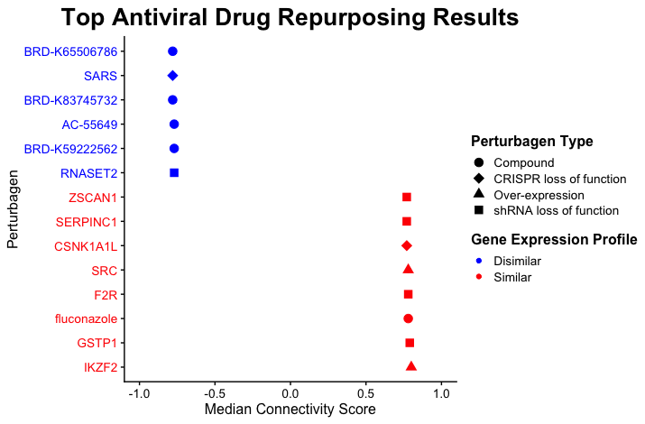

Slide 26

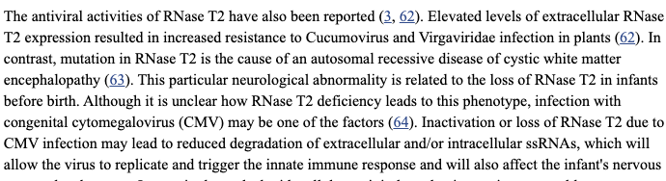
What can we learn from the scatterplot?

Slide 27
LEARNING OBJECTIVES
Understand what drug repurposing analyses are and how to use it as a tool for host-pathogen data
Create a basic plot in R to visualize CLUE results
Refine R plot components for specific colours, shapes and sizes
Combine multiple plots in R and output as a file to the desktop
Learn how to produce a similar figure in Tableau

Slide 28

Purpose of making a bar plot
Compare between similar and dissimilar perturbagen types
How many perturbagens are in each category
Which perturbagen types are the most/least common
How the perturbagen types differ between expression profiles

Slide 29
Going over to RStudio…

Slide 30
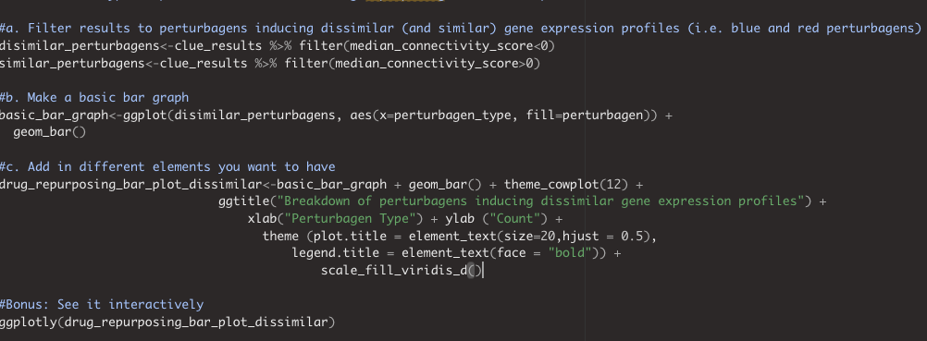
Step 6. Create a bar plot to compare the different gene expression profiles

Slide 31
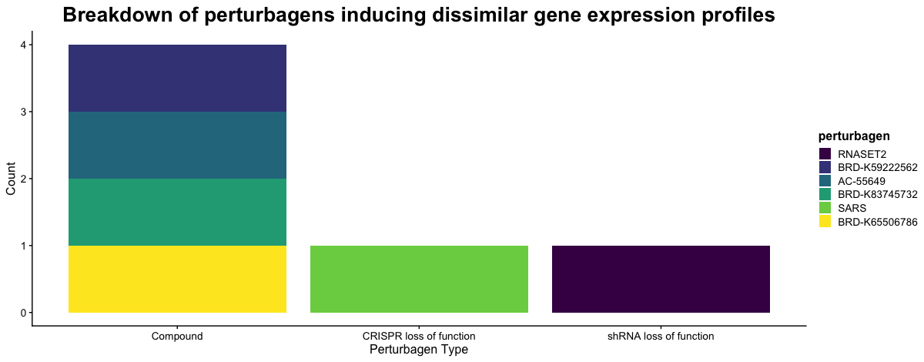

Slide 32
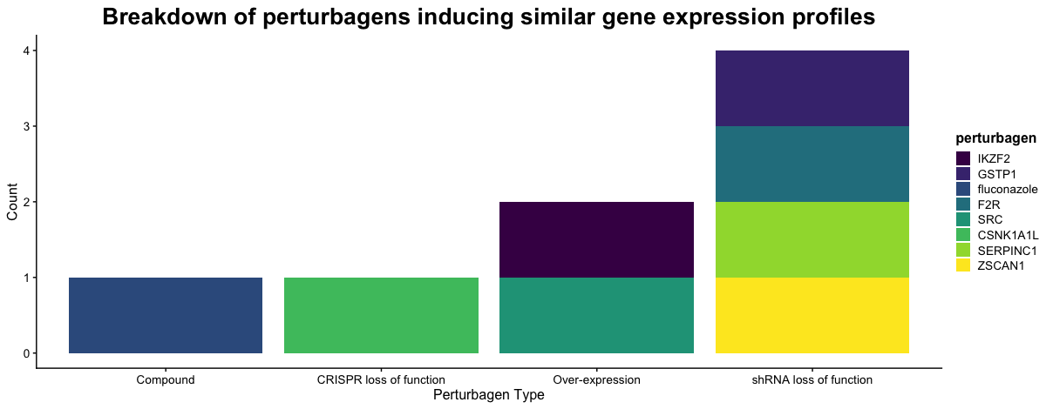

Slide 33


What can we learn from the bar plot?
Dissimilar gene expression profile perturbagens
Most common: compound
Less perturbagens (n=6)
3 types of perturbagens
Similar gene expression profile perturbagens
Most common: shRNA loss of function
More perturbagens (n=8)
4 types of perturbagens

Slide 34
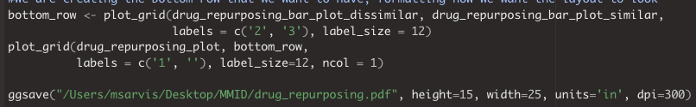
Step 7. Combine the plots together and save to your computer desktop

Slide 36
LEARNING OBJECTIVES
Understand what drug repurposing analyses are and how to use it as a tool for host-pathogen data
Create a basic plot in R to visualize CLUE results
Refine R plot components for specific colours, shapes and sizes
Combine multiple plots in R and output as a file to the desktop
Learn how to produce a similar figure in Tableau

Slide 37



RStudio (ggplot2) Vs Tableau
More control
Can save to desktop
Can do data analysis
Can be interactive with Plotly or Shiny
Artistic freedom
Dashboard is interactive
Less coding
Less control
Only saves to online website
Limited capabilities with free version
Need to code

Slide 38
Going over to Tableau…

Slide 39
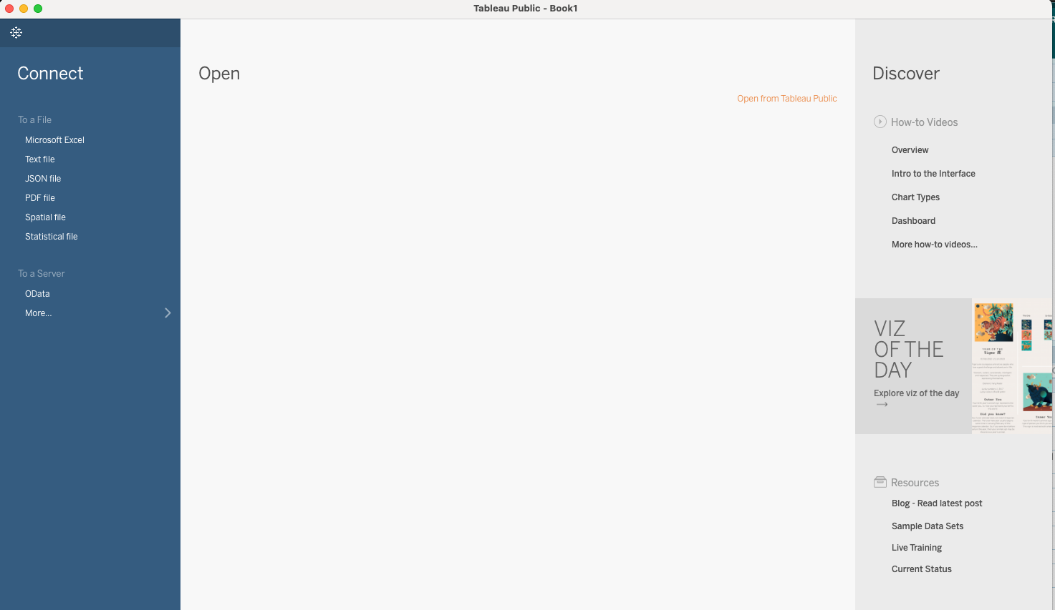
1. Import your Excel file
https://public.tableau.com/en-us/s/
Enter an email and the app will install! Also make an account to save visualizations.

Slide 40
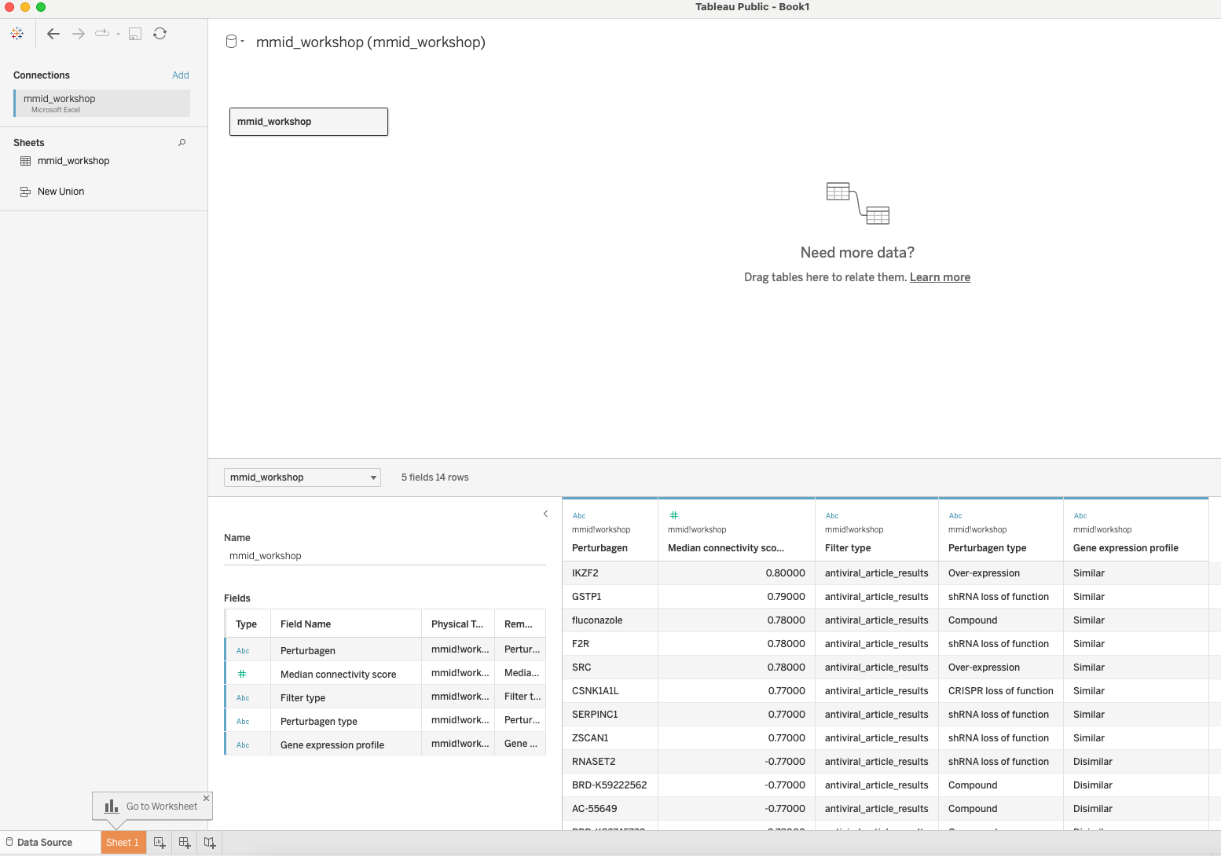

2. Put in your sheet and look at potential options
Where you load in data
Work on data visualizations
Combine all visualizations into a dashboard
Combine dashboards into a storyboard

Slide 41
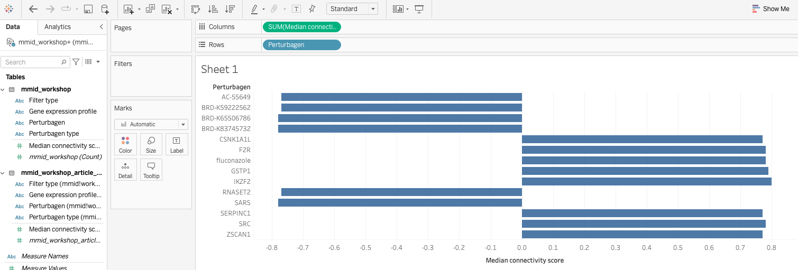
3. Create a scatterplot of results in Worksheet 1

Slide 42
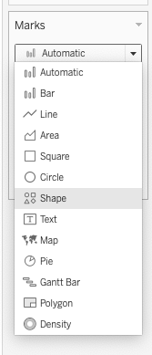
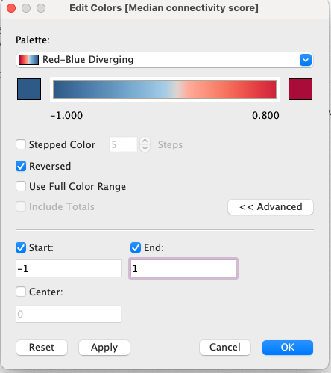
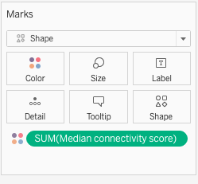
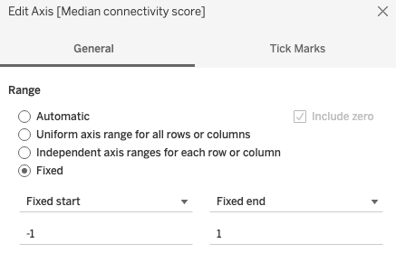
Add in colours, shapes, etc
b. Make x axis limits and rename axis
c. Make colours based on median connectivity score
d. Make negative colours blue and positive colours red
a. Choose graph type

Slide 43

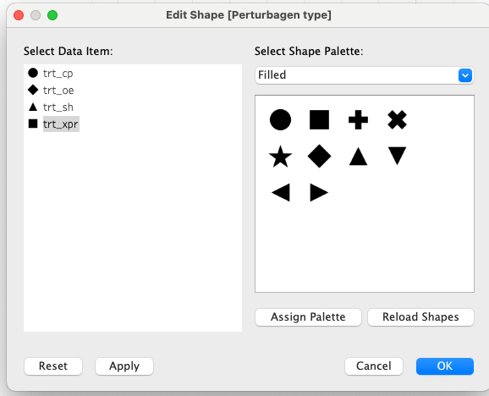

Add in colours, shapes, etc
e. Sort so that the connectivity scores are ordered as you like
f. Make perturbagen type a specific shape
g. Select specific shapes for each perturbagen type

Slide 44
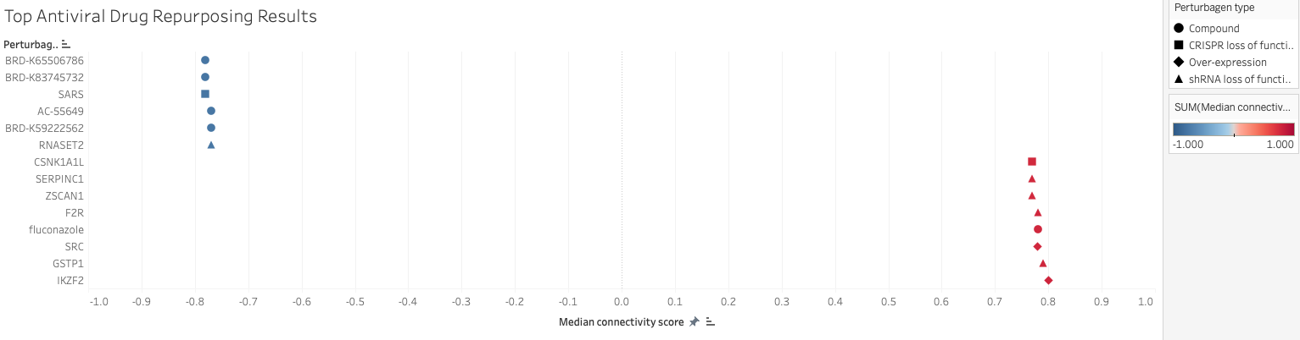
Final Scatterplot!

Slide 45
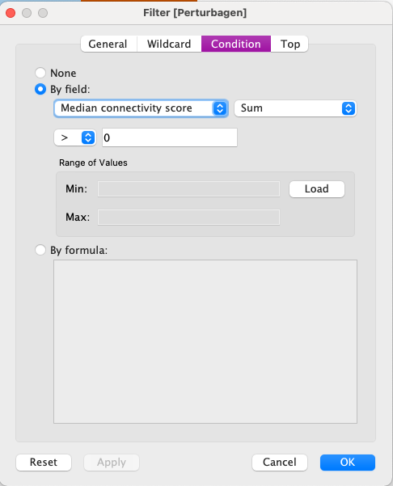
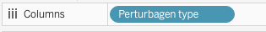
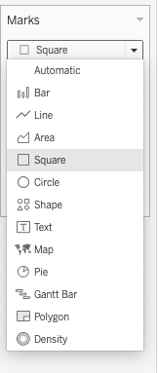
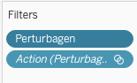
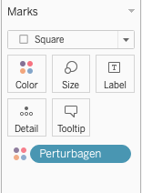
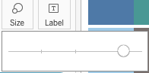

4. Create bar charts of data
c. Filter perturbagens in the bar graph by connectivity score
a. Create square graph with only one column value
e. Write the perturbagen names on the graph
b. Make perturbagen a square colour
d. Increase the square sizes

Slide 46
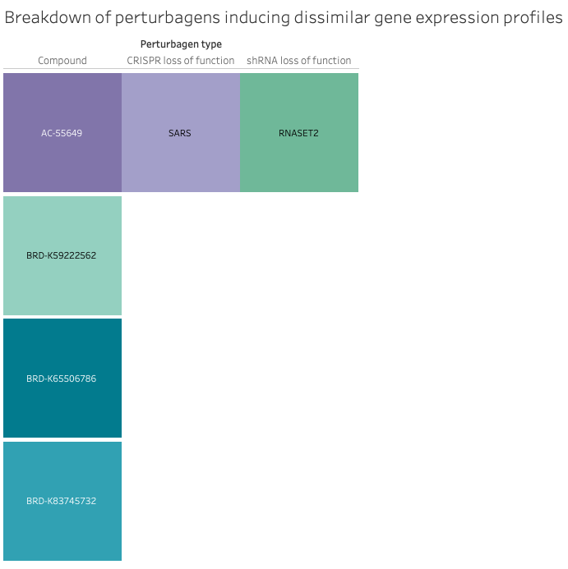
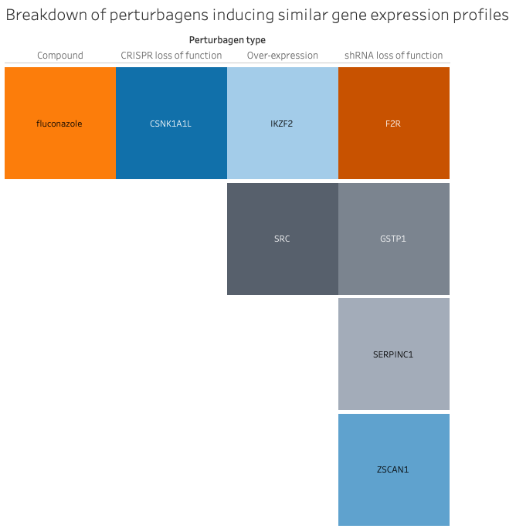
Bar charts produced in Tableau

Slide 47
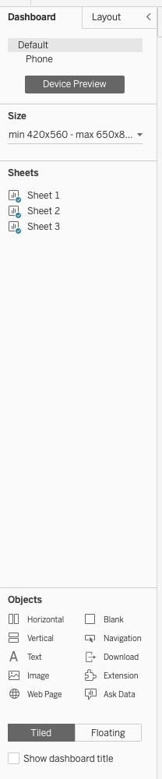
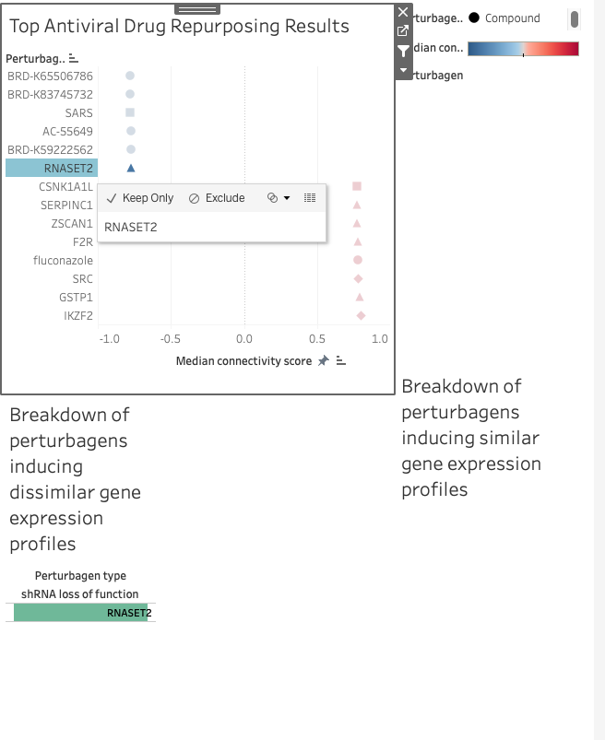
5. Combine all graphs on Dashboard
Interactive element!
a. Different layouts you can have as well as objects you can insert (i.e. hyperlink, extension, etc)
b. Clicking the filter button on one graph and clicking on a perturbagen, can bring that one up on another graph

Slide 48
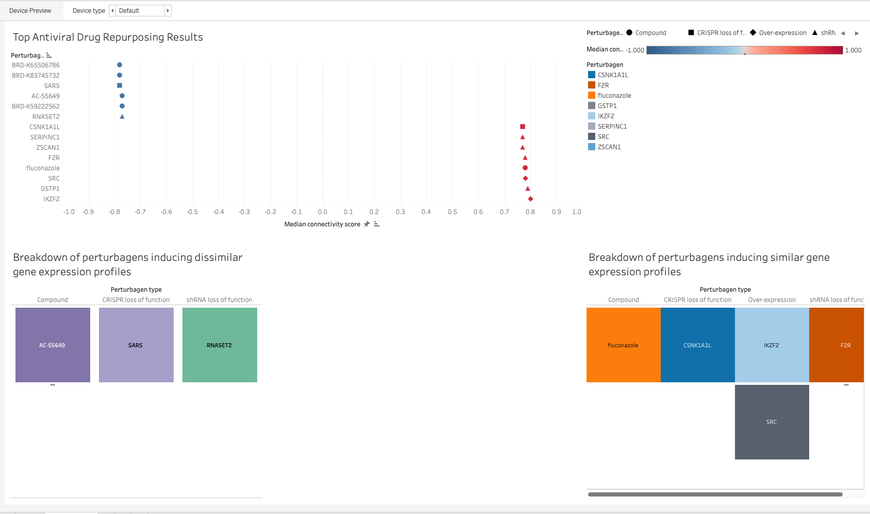
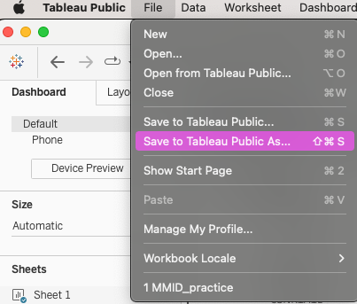
5. Combine all graphs on Dashboard
c. Save dashboard to Tableau public account

Slide 49
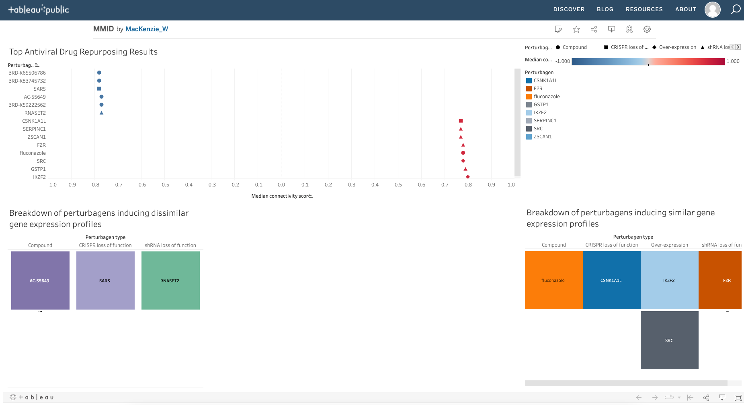
Tableau vs RStudio Drug Repurposing Graphs

Slide 50
Tableau vs RStudio Drug Repurposing Graphs

Slide 51


HELPFUL RESOURCES
CLUE/CMap
ggplot2
ggplot2/tidyverse
cow_plot
Tableau
Videos
Drug Repurposing Hub at Broad Institute
CMap Analysis

Slide 52
THANK YOU FOR ATTENDING!
The Q&A Session will now begin.
Please make sure to fill out the Exit Survey
We value your feedback!
More questions? Please email us at
mmid.coding.workshop@gmail.com or post them to the workshop slack channel
Educational series supported by the Department of MMID to promote knowledge translation and dissemination among students and researchers

